Slide 1
RIPE 85 – Euro-IX Update
Maria Isabel Gandia Carriedo - Euro-IX Board

Slide 2
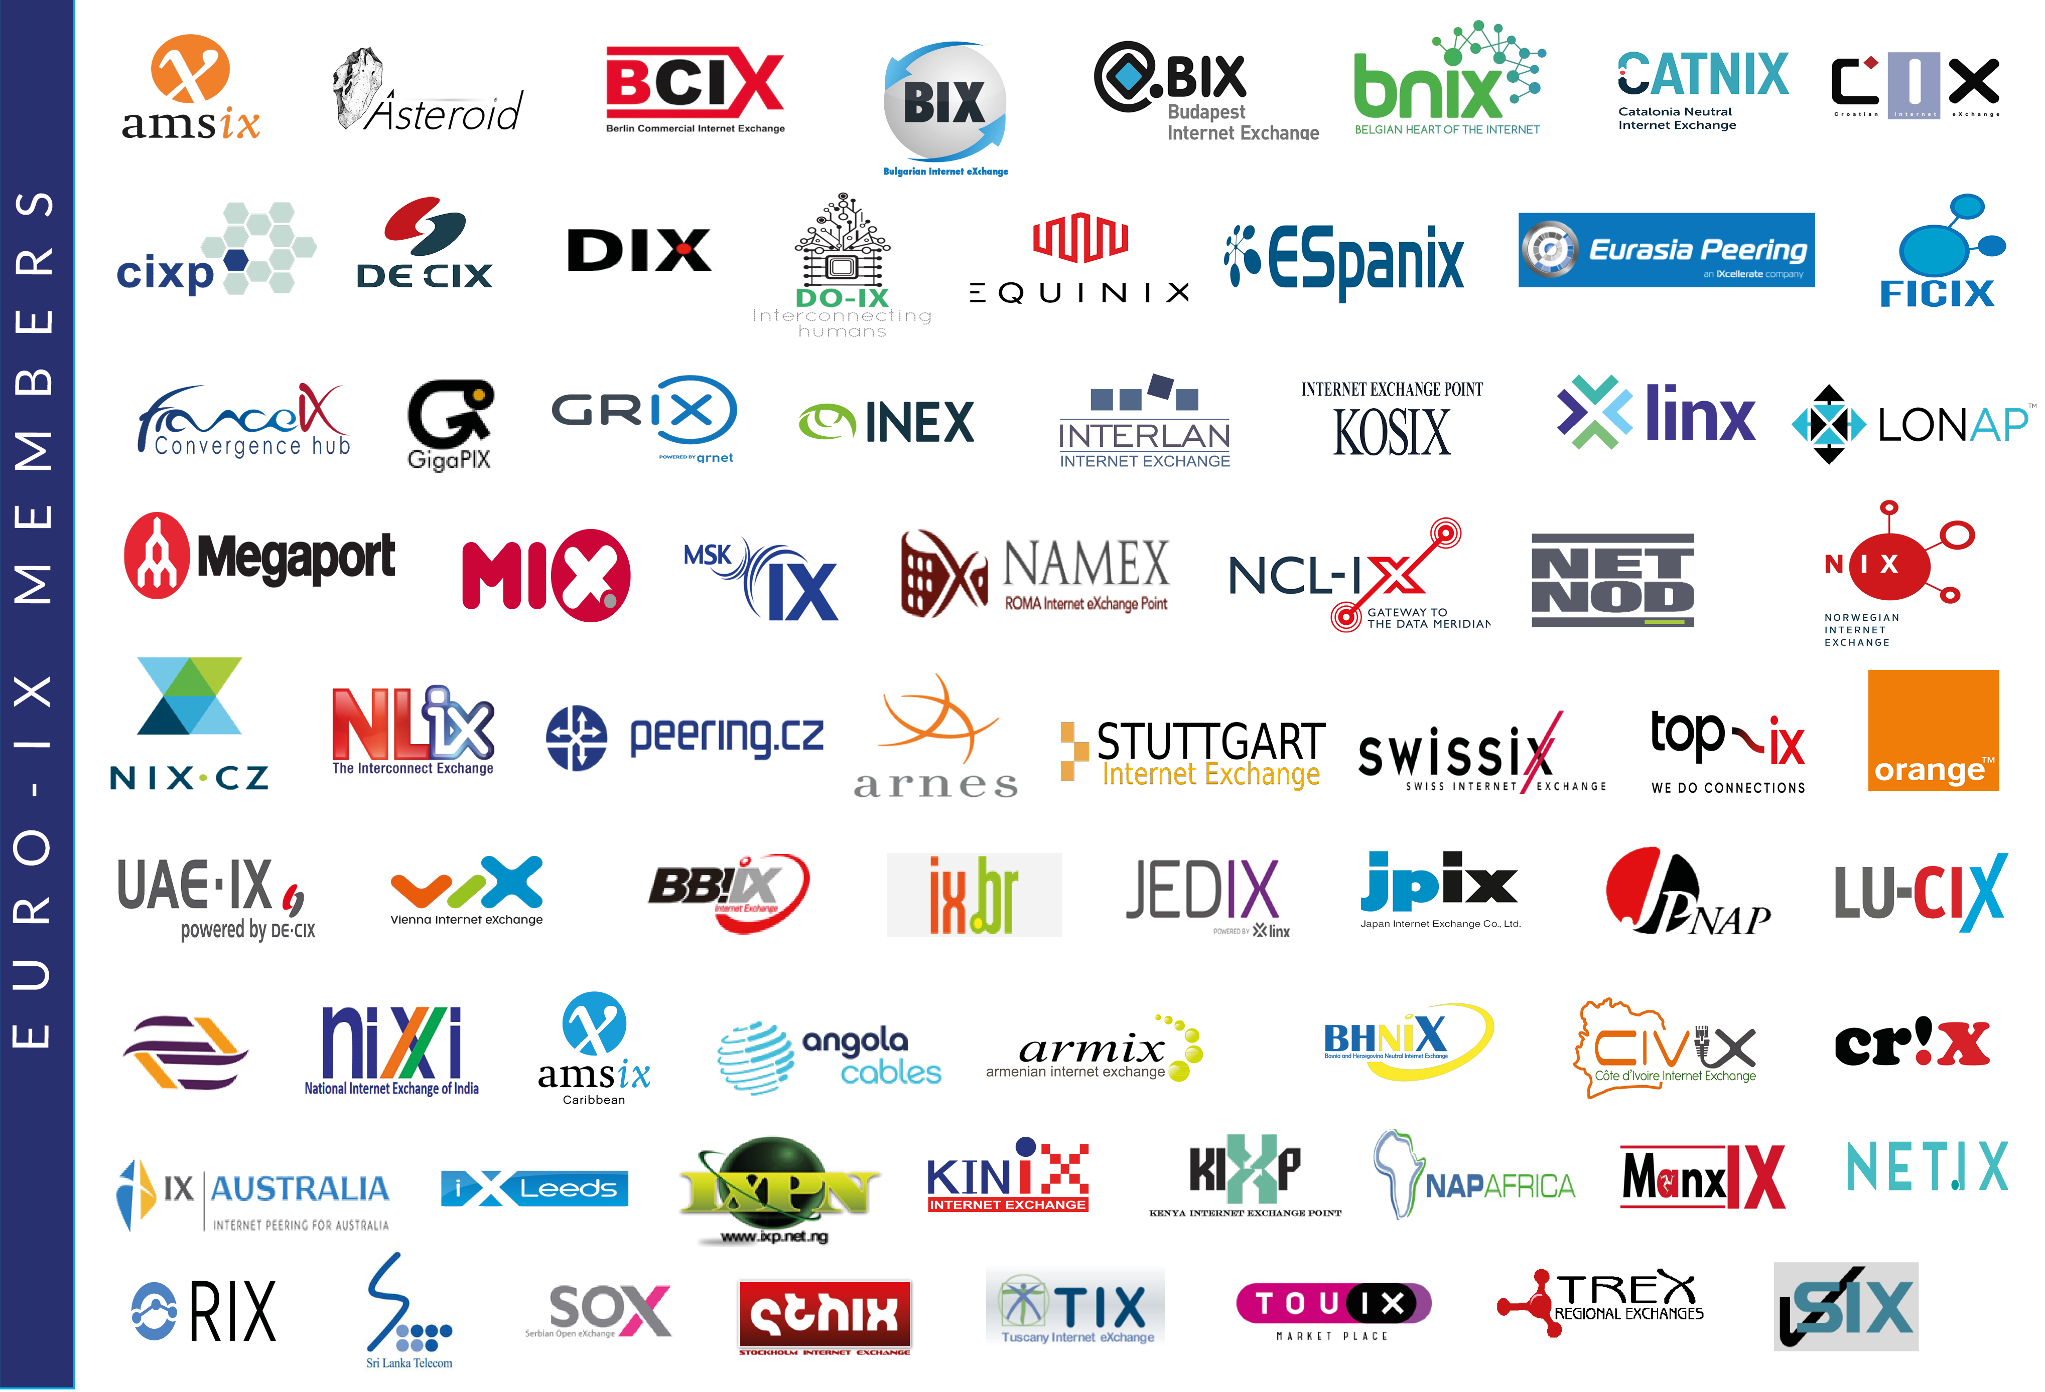

Slide 4
Membership Association of IXPs
Events
Services
Tools & Community Projects
Internet eXchange Point Database – IXPDB
Peering Toolbox
Fellowship & Mentor-IX
Route Server Large BGP Communities list
A new IXP Film
Two Membership events per year hosted by our Members
Workshops & hackathons
Online/ virtual workshops
Reports
Newsletters
Mailing list
IXP Benchmarking

Slide 5
TOP-IX Update
Celebrating 20 years of activity!
New game on interconnection: https://flows.top-ix.org/en/
New IXP announced in Genoa (in cooperation with other partners): https://www.ge-dix.net/
The new Self-Service Portal is available for all customers, which allows on-demand ordering and provisioning of Interconnection services (e.g. Peering, Cloud Connectivity)
DE-CIX announced 5th location in the US: DE-CIX Phoenix
DE-CIX Dallas topped 300Gbps
DE-CIX Frankfurt topped at 10,7Tbps
IX-API: The work on Version 3 covering Monitoring and Statistics just started. Input on features and the specification is highly appreciated!

Slide 6
Espanix Update
Connected their fifth PoP in Madrid with Data4.

Slide 7
InterLAN Update
130 ASNs connected, daily peak traffic 400 Gbps
Partnership Agreement with DE-CIX, enabling Romanian Networks and Enterprises to access the world’s largest neutral interconnection ecosystem
Commitment to support community projects: Euro-IX Fellowship, IXPDB, IXP Manager, PeeringDB, Global NOG Alliance
The new Self-Service Portal is available for all customers, which allows on-demand ordering and provisioning of Interconnection services (e.g. Peering, Cloud Connectivity)
DE-CIX announced 5th location in the US: DE-CIX Phoenix
DE-CIX Dallas topped 300Gbps
DE-CIX Frankfurt topped at 10,7Tbps
IX-API: The work on Version 3 covering Monitoring and Statistics just started. Input on features and the specification is highly appreciated!

Slide 8
BNIX & LU-CIX Update
Are happy to announce the go-live of their interconnection.
This allows participants/members of the two IX’s to add remote peering on the partner exchange for a small fee
Reducing latency times between the two countries and ensuring greater security for cross-border traffic flows.
The new Self-Service Portal is available for all customers, which allows on-demand ordering and provisioning of Interconnection services (e.g. Peering, Cloud Connectivity)
DE-CIX announced 5th location in the US: DE-CIX Phoenix
DE-CIX Dallas topped 300Gbps
DE-CIX Frankfurt topped at 10,7Tbps
IX-API: The work on Version 3 covering Monitoring and Statistics just started. Input on features and the specification is highly appreciated!

Slide 9
LINX Update
LINX Developments
LON1 now at 6Tbps+ peak
Total LINX Traffic 7Tbps +
New LINX London PoP at Iron Mountain Data Centers LON-1
LINX International Developments
LINX Launches IXP in Nairobi, Kenya
Creating a regional hub in East Africa
The new Self-Service Portal is available for all customers, which allows on-demand ordering and provisioning of Interconnection services (e.g. Peering, Cloud Connectivity)
DE-CIX announced 5th location in the US: DE-CIX Phoenix
DE-CIX Dallas topped 300Gbps
DE-CIX Frankfurt topped at 10,7Tbps
IX-API: The work on Version 3 covering Monitoring and Statistics just started. Input on features and the specification is highly appreciated!

Slide 10
LINX Update
Cont..LINX International Developments
Partnership with Kenyan IXAfrica - LINX and NAPAFrica announce strategic collaboration - Continued strong growth at LINX JEDIX (317 Gbps)
LINX Service developments
New Analytics features in IX-API Collaboration between LINX, Ams-IX & DE-CIX
The new Self-Service Portal is available for all customers, which allows on-demand ordering and provisioning of Interconnection services (e.g. Peering, Cloud Connectivity)
DE-CIX announced 5th location in the US: DE-CIX Phoenix
DE-CIX Dallas topped 300Gbps
DE-CIX Frankfurt topped at 10,7Tbps
IX-API: The work on Version 3 covering Monitoring and Statistics just started. Input on features and the specification is highly appreciated!

Slide 11
France-IX Update
France-IX merged with Rezopole in 2021. LyonIX is now France-IX Lyon/AURA.
400G ports for members available NOW
moving backbone from N x 100G transponders to 400G-ZR (ongoing)
more than 100 100G ports in Paris
The new Self-Service Portal is available for all customers, which allows on-demand ordering and provisioning of Interconnection services (e.g. Peering, Cloud Connectivity)
DE-CIX announced 5th location in the US: DE-CIX Phoenix
DE-CIX Dallas topped 300Gbps
DE-CIX Frankfurt topped at 10,7Tbps
IX-API: The work on Version 3 covering Monitoring and Statistics just started. Input on features and the specification is highly appreciated!

Slide 12
France-IX Update
Traffic peaks : Paris 1.85 Tbps, Lyon 64 Gbps, Marseille 270 Gbps
Members from TOUIX moved to France-IX Toulouse
France-IX Lille open
The new Self-Service Portal is available for all customers, which allows on-demand ordering and provisioning of Interconnection services (e.g. Peering, Cloud Connectivity)
DE-CIX announced 5th location in the US: DE-CIX Phoenix
DE-CIX Dallas topped 300Gbps
DE-CIX Frankfurt topped at 10,7Tbps
IX-API: The work on Version 3 covering Monitoring and Statistics just started. Input on features and the specification is highly appreciated!

Slide 13
DE-CIX Update
DE-CIX Leipzig launched Oct. 13th, RFS November 15th , available at Datacenter Leipzig - envia TEL GmbH & Colocation Leipzig Mitte (ZNK) - PŸUR Business
DE-CIX Frankfurt – 800 G available now to further increase efficiency in platform operations and network costs.
The new Self-Service Portal is available for all customers, which allows on-demand ordering and provisioning of Interconnection services (e.g. Peering, Cloud Connectivity)
DE-CIX announced 5th location in the US: DE-CIX Phoenix
DE-CIX Dallas topped 300Gbps
DE-CIX Frankfurt topped at 10,7Tbps
IX-API: The work on Version 3 covering Monitoring and Statistics just started. Input on features and the specification is highly appreciated!

Slide 14
DE-CIX Update
DE-CIX celebrates the 10th birthday of UAE-IX powered by DE-CIX in November in Dubai with famous peering cruise. (pls. see attachment)
DE-CIX honored recently as Best Internet Exchange Operator the the Carrier Awards for the 7th time
The new Self-Service Portal is available for all customers, which allows on-demand ordering and provisioning of Interconnection services (e.g. Peering, Cloud Connectivity)
DE-CIX announced 5th location in the US: DE-CIX Phoenix
DE-CIX Dallas topped 300Gbps
DE-CIX Frankfurt topped at 10,7Tbps
IX-API: The work on Version 3 covering Monitoring and Statistics just started. Input on features and the specification is highly appreciated!

Slide 15
IXPDB Status
15

Slide 16
IXP{DB} Road Map
Structured Data
Building Data Pipelines
Next Steps
Enables users:
Visualise the data via Maps and Charts
Dynamic filters
Downloadable data sets in structured formats
We are able to:
- Collect and organise the data
Encourage IXPs to adopt to the schema
Data validation – coming soon!
Finalise traffic API and build traffic trend datasets
Enable the comparison tool
Develop a pricing API
Identify useful 3rd party data

Slide 17
IXPDB Sponsors
Contact secretariat@ix-f.net if you’d like to find out more or sponsor us!

Slide 18
Other Information
Mailing list for users - https://lists.euro-ix.net/mailman/listinfo/ixpdb
GitHub JSON Member List Schema – https://github.com/euro-ix/json-schemas
API – https://api.ixpdb.net
Website - https://ixpdb.euro-ix.net/en/
IXPDB admin team - ixpdb-admin@euro-ix.net

Slide 19
Thank You!

