Slide 1
PeeringDB Operations & Product Update
Arnold Nipper
arnold@peeringdb.com

Slide 2
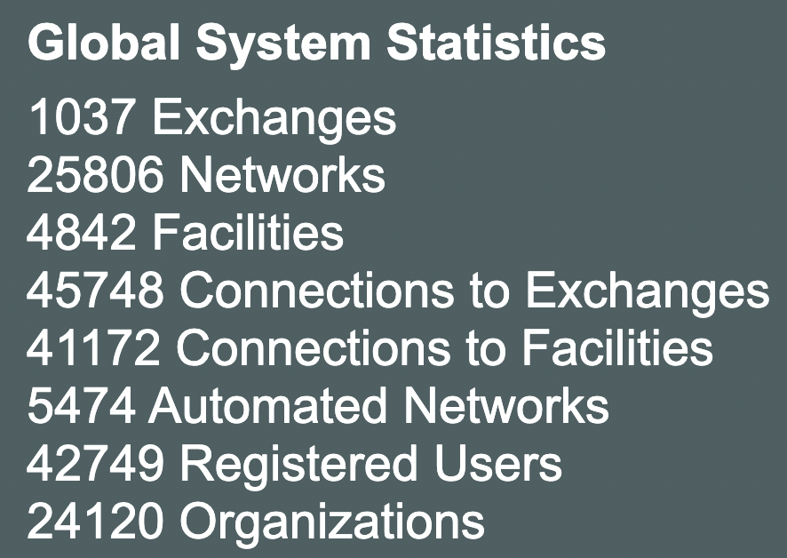
What is PeeringDB?
PeeringDB is a freely available, user-maintained, database of networks, and the go-to location for interconnection data. It facilitates the global interconnection of networks at IXPs, data centers, and other interconnection facilities. It is the first stop in making interconnection decisions.
2022-10-26
RIPE85, Connect-WG, Belgrade, Serbia
Notes:
We have live stats on the front page of PeeringDB
These are a few weeks out of date but it’s worth noting that we now have over 1,000 IXPs and are approaching 50k connections to IXPs

Slide 3
Committees
Admin Committee | Operations Committee | Outreach Committee | Product Committee
Manage administration of user accounts and PeeringDB records Answer support tickets Cleansing and completion of PeeringDB records Leads: Patrick Gilmore (Chair) and Darwin Costa (Vice Chair) Contact: admincom@ lists.peeringdb.com | Manage PeeringDB infrastructure Leads: Job Snijders (Chair) and Aaron Hughes (Vice Chair) Contact: pdb-ops@ lists.peeringdb.com | Manage marketing and social media Develop and maintain presentations, workshops and webinars Coordinate presentations and attendance at events Leads: Ben Ryall (Chair) and Bijal Sanghani (Vice Chair) Contact: outreachcom@ lists.peeringdb.com | Manage roadmap and development priorities Ask for input from the community on desired features Write SoWs to solicit bids to complete requested features Leads: Stephen McManus (Chair) and Matt Griswold (Vice Chair) Product Manager: Leo Vegoda Contact: productcom@ lists.peeringdb.com

Slide 4
We are looking for volunteers
For Admin Committee
who speak languages other than English
For Outreach Committee
Folks with marketing experience are highly welcome
For Operations Committee
Small and highly trusted
Experience with containers is a plus
Apply to stewards@lists.peeringdb.com

Slide 5
Support Ticket Statistics
300% Increase!
Admin Committee volunteers are based around the world in a variety of time zones with diverse language skills
Goal is to resolve support tickets within 24 hours
Notes:
The increase in tickets from 1.0 to 2.0 are primarily due to new registrations.

Slide 6
Recent Volunteer Contributions
Focus on volunteer contributions
Security changes from Amazon
UX changes from Google
Various other changes from individuals
2022-10-26
RIPE85, Connect-WG, Belgrade, Serbia
Notes:
We focus our development on areas that will have the most impact for users but some users need their own changes
They can develop for PeeringDB and coordinate with us to get their code included. We have had contributions from Amazon, Google, and several individuals. We have a guide on how to contribute in our HOWTO documentation archive and welcome contributions from IXPs
Note that the HOWTO series was inspired by the survey responses

Slide 7
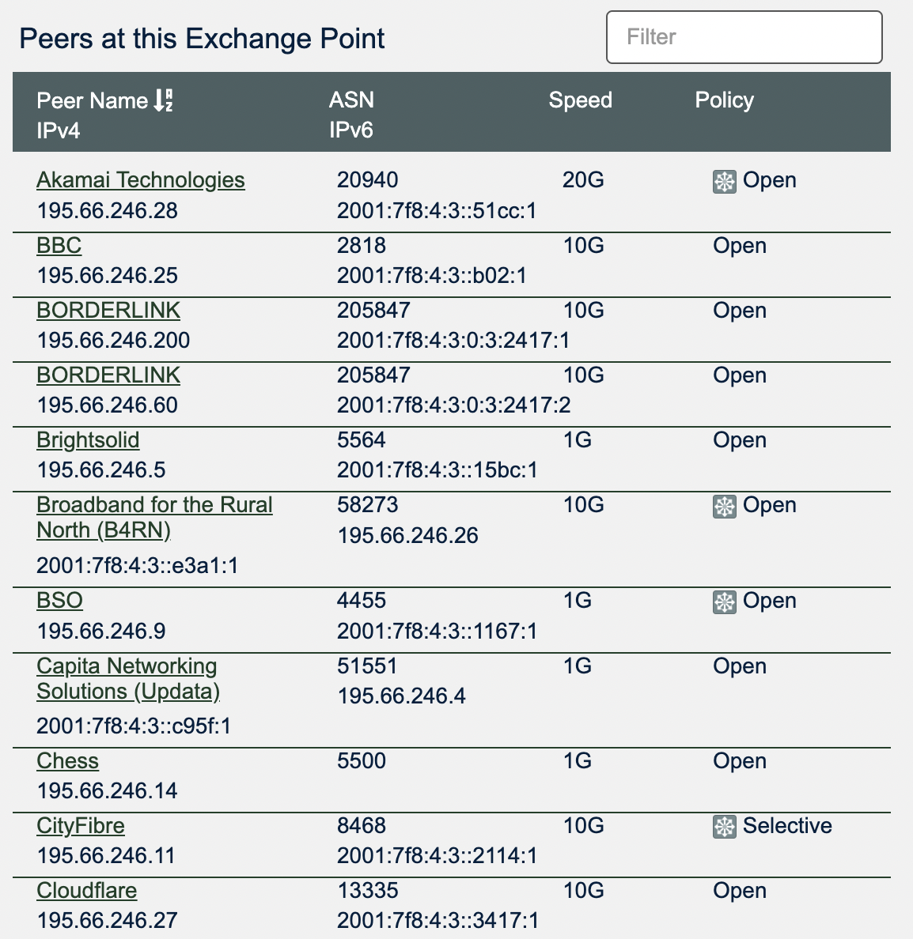
Recent Product Improvements
Better support tools
Better IX-F Export handling
Networks peering with Route Servers now more visible
Organizational policy features allow to require your users to:
Enable MFA
Use a specific email domain
Periodically revalidate their accounts
And users can associate multiple addresses with an account
2022-10-11
37th Euro-IX Forum, Edinburgh, UK
Notes:
The tools our support team use to help users has been a recent focus
Improvements that are very important to IXPs include better IX-F Export handling and a small icon that shows when a network peers with the RS
2.40.0 includes a series of organizational policy features that might be important for IXP, networks and facilities

Slide 8
General Updates
https://www.peeringdb.com is enforced (2.35.0)
Please check your scripts (e.g. –L for curl)
Enables better delivery via CDNs
Lots of bug fixes and small features
Users especially like the logo feature
Various counters for fac, ix and net objects
Updated fields allow for easy tracking of changes
netixlan_updated
netfac_updated
poc_updated
2022-10-26

Slide 9
Authentication Changes
API keys (2.26.0)
256-bit random number, base-62 encoded
On org level (additional tabs)
Needs an email associated with it (ideally role-account)
Can be created by any Admin
Same granular (CRUD) permissions as users
On user level
HOWTO: https://docs.peeringdb.com/howto/api_keys/
Substantially rate-limit unauthenticated API queries (2.34.0)
Wild running scripts
Bad code
See tech-list for details
HOWTO: https://docs.peeringdb.com/howto/work_within_peeringdbs_query_limits/

Slide 10
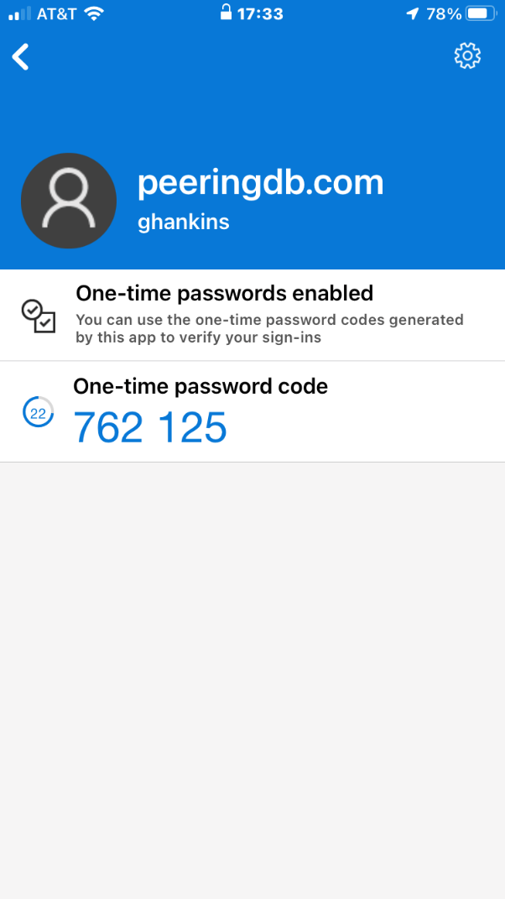
Account Security
Two-factor authentication (2FA) (2.21.0)
Using time-based one-time password (TOTP) - no SMS, no email
Setup via User Profile
Highly recommended
Provision for backup codes and recovery tokens
Fast IDentity Online (FIDO) Universal 2nd Factor (U2F) 2FA support (2.33.0)
Allowing users to enable 2FA without relying on a TOTP app
HOWTO: https://docs.peeringdb.com/howto/authenticate/
2022-10-26

Slide 11
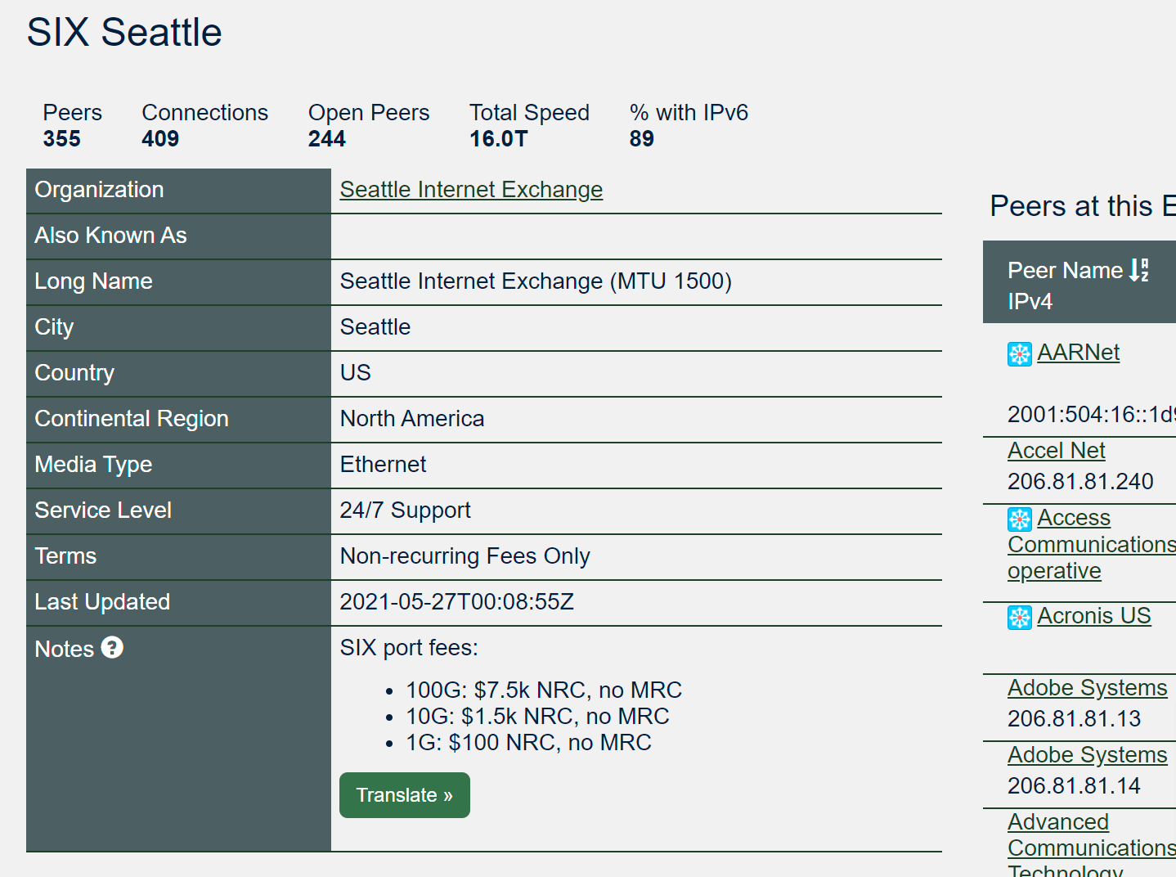
Self-Selection Fields – Exchanges (2.27.0)
Service Level
Best Effort (no SLA)
Normal Business Hours
24/7 Support
Not Disclosed (default)
Terms
No Commercial Terms
Bundled with other Services
NRC only
Recurring Fees
Not Disclosed (default)
2022-10-26

Slide 12
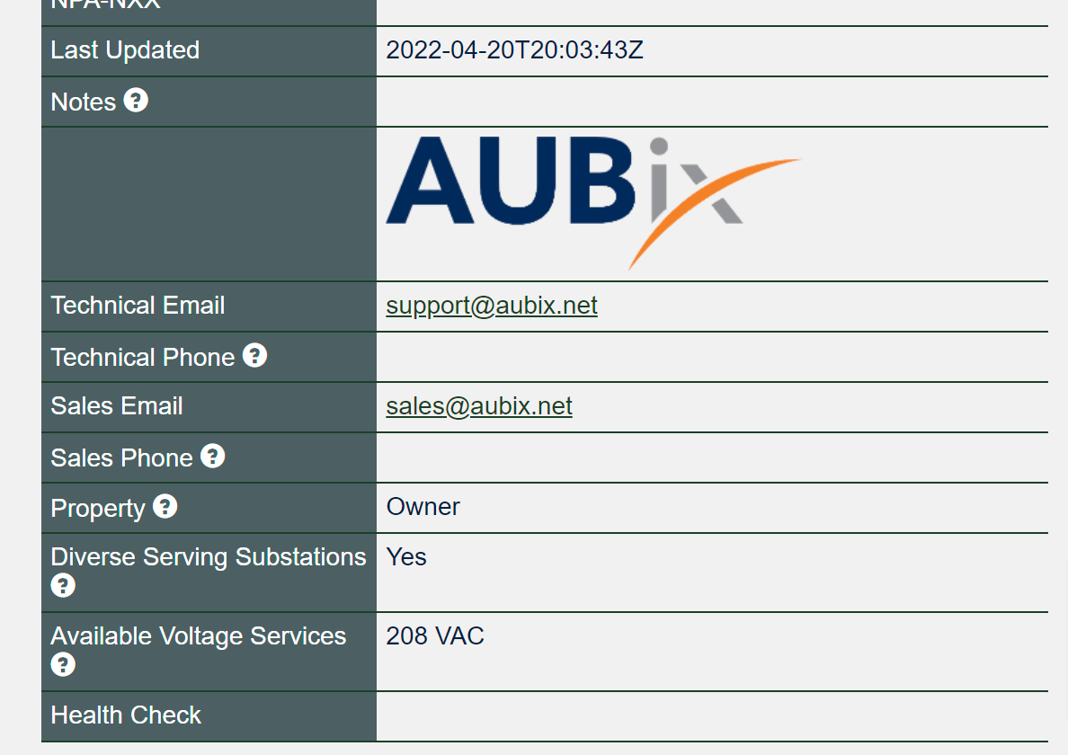
Self-Selection Fields – Facilities (2.30.0)
Property
Lessee
Owner
Not Disclosed (default)
Diverse Serving Substations
Yes
No
Not Disclosed (default)
Available Voltage Services
48 VDC
120 VAC
208 VAC
240 VAC
480 VAC

Slide 13
Searching
Improvement from NANOG 83 Hackathon (2.33.0)
Searching for numbers return the most relevant results
Searching for a short ASN returns just that ASN
Searching for two segments of an IP address return related ix and netixlan objects
HOWTO: https://docs.peeringdb.com/howto/search/

Slide 14
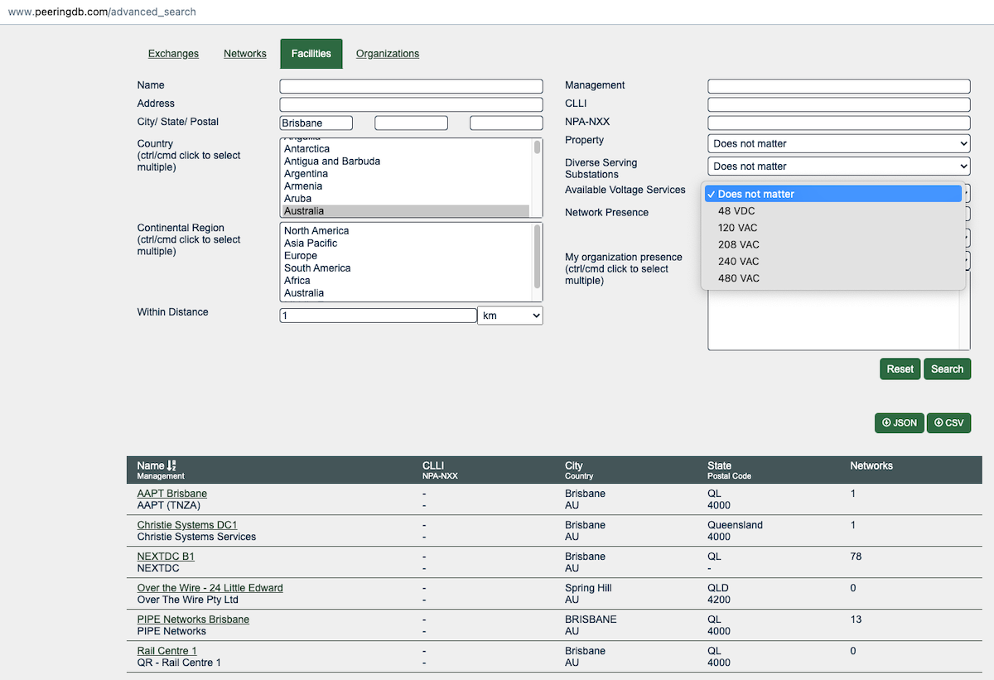
Searching – Facilities
The address is mapped to coordinates
Search a radius from any location
Filter searches on criteria
Export as JSON or CSV
Additional information
Property Ownership
Redundancy
Power Provided

Slide 15
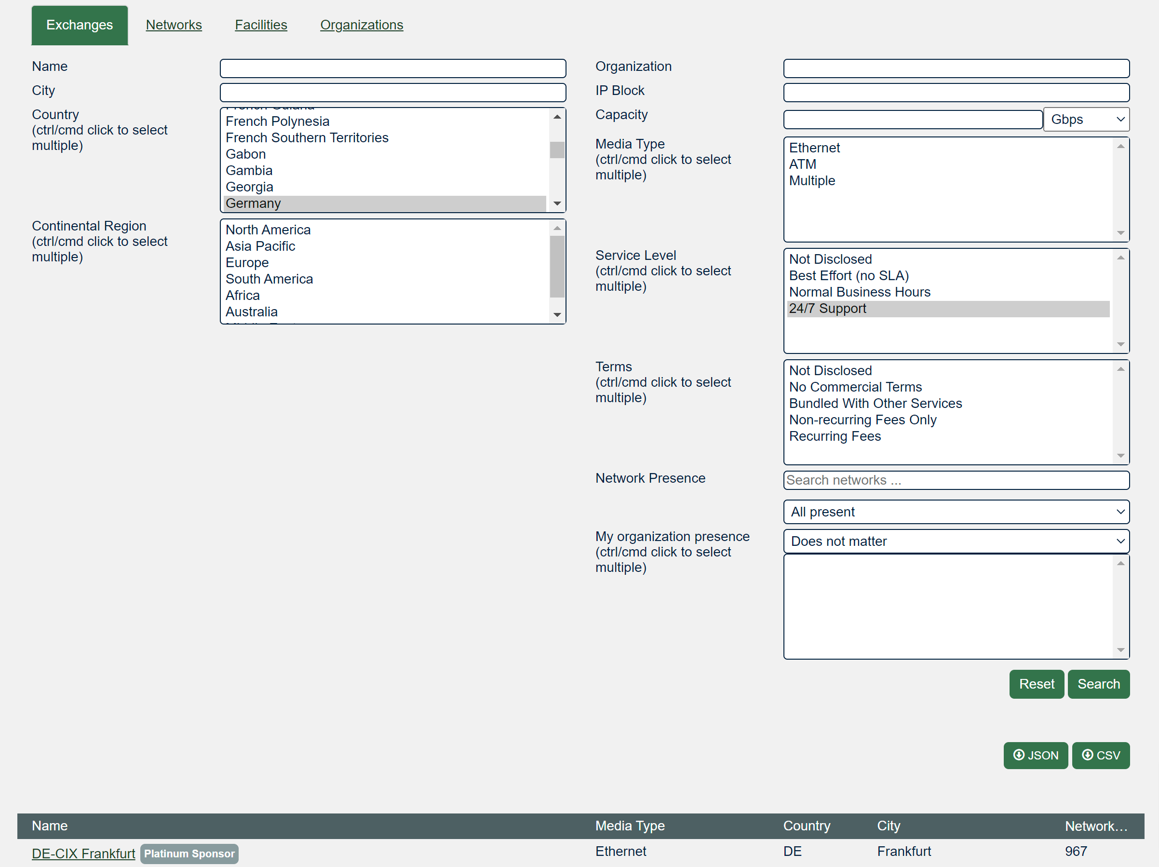
Searching – Exchanges
Filter searches on criteria
Export as JSON or CSV
Additional information
Service Level
Terms
Network Presence

Slide 16
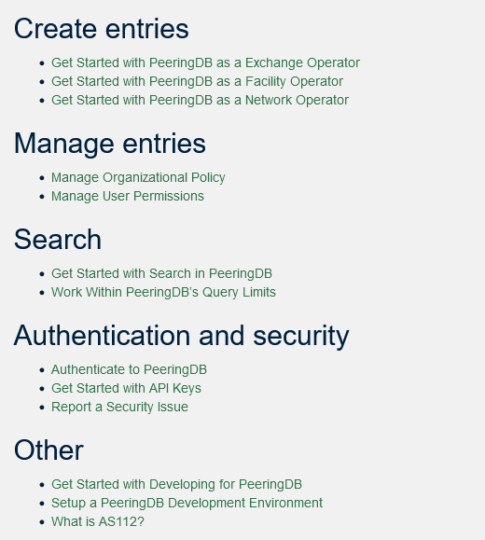
Documentation Updates
Started series of HOWTOs
https://docs.peeringdb.com/howtos/
Regular blogs on new features
https://docs.peeringdb.com/blogs/
Announced on social media

Slide 17
What’s ahead?
Regular updates with small features and bug fixes
Improve searching
Both for GUI and API
Finalize tasks from Data Ownership Task Force
Automatically remove stale connections to an IX
Automate Approving Networks, IXPs, and Facilities according to the latest Guidelines and Criteria
Published release schedule on the Release Notes page
Release number | Internal testing | Beta release | Production release
2.41.0 | 2022-10-04 | 2022-10-11 | 2022-10-25
2.42.0 | 2022-11-01 | 2022-11-08 | 2022-11-15
2.43.0 | 2023-01-10 | 2023-01-17 | 2023-01-24
2.44.0 | 2023-01-31 | 2023-02-07 | 2023-02-21
2.45.0 | 2023-03-07 | 2023-03-14 | 2023-03-21
2022-10-26

Slide 18
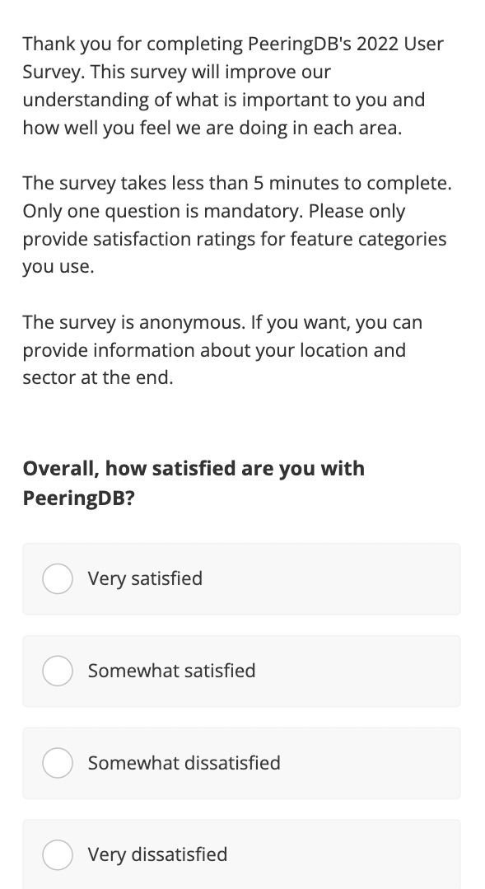
2022 User Survey
Our 2022 user survey is open until October 16th
Available in 6 UN languages, Portuguese & Ukrainian
Please take the survey
Please share it with other PeeringDB users in your organization
https://surveyhero.com/c/pdb22e
Notes:
Our annual survey is now open. Please take the survey and tell us what you value and what you want.
And please ask colleagues who also use PeeringDB to take the survey. WE had about 250 responses last year but want to get the most responses we can, so we understand what users want and need

Slide 19
Thank you to our sponsors!
Diamond Sponsor
Platinum Sponsors
Gold Sponsors
Silver Sponsors
2022-10-26
Notes:
Logo height proportions: 100%, 85%, 65%, 40%

Slide 20
Questions?
Need help? Contact support@peeringdb.com
Got a feature idea? Contact productcom@lists.peeringdb.com

