Slide 1
MANRS: Eight Years of Successes and Challenges
And how you can help for the next eight
Andrei Robachevsky
robachevsky@isoc.org

Slide 2
MANRS is an industry initiative aimed at improving the security and reliability of the global Internet routing system.
MANRS is based on collaboration among participants and shared responsibility for the Internet infrastructure.
MANRS sets a new norm for network operations

Slide 3
Why is routing security so hard?
Each network can contribute to routing security
And be the cause of an incident
Most of them would like to have a more secure routing system
Routing incidents are hard to debug and fix
Most of them have little incentive
One’s network security is in the hands of others

Slide 4
Solving the collective action problem
Regulation doesn’t really help
Global span and dependencies
Making good practices a norm
Widely accepted
Not exactly a least common denominator, but not too high either
Visible and Measurable

Slide 5
An approach: Mutually Agreed Norms for Routing Security (MANRS)
Defines the baseline security in the form of Actions
Builds a visible community of operators implementing this baseline

Slide 6
MANRS Programs
Network Operators (2014)
Internet Exchange Points (2018)
Content Delivery Networks (CDNs) and Cloud Providers (2020)
Network Equipment Vendors (2021)

Slide 7
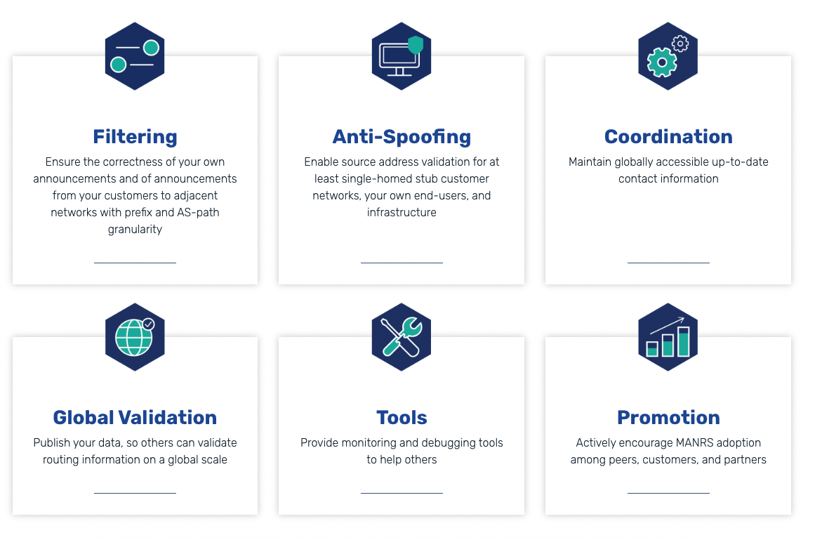

Slide 8
MANRS: A Collaborative Effort
Notes:
https://www.manrs.org/wp-content/uploads/sites/14/2017/10/MANRS-451-Study-Report.pdf

Slide 9
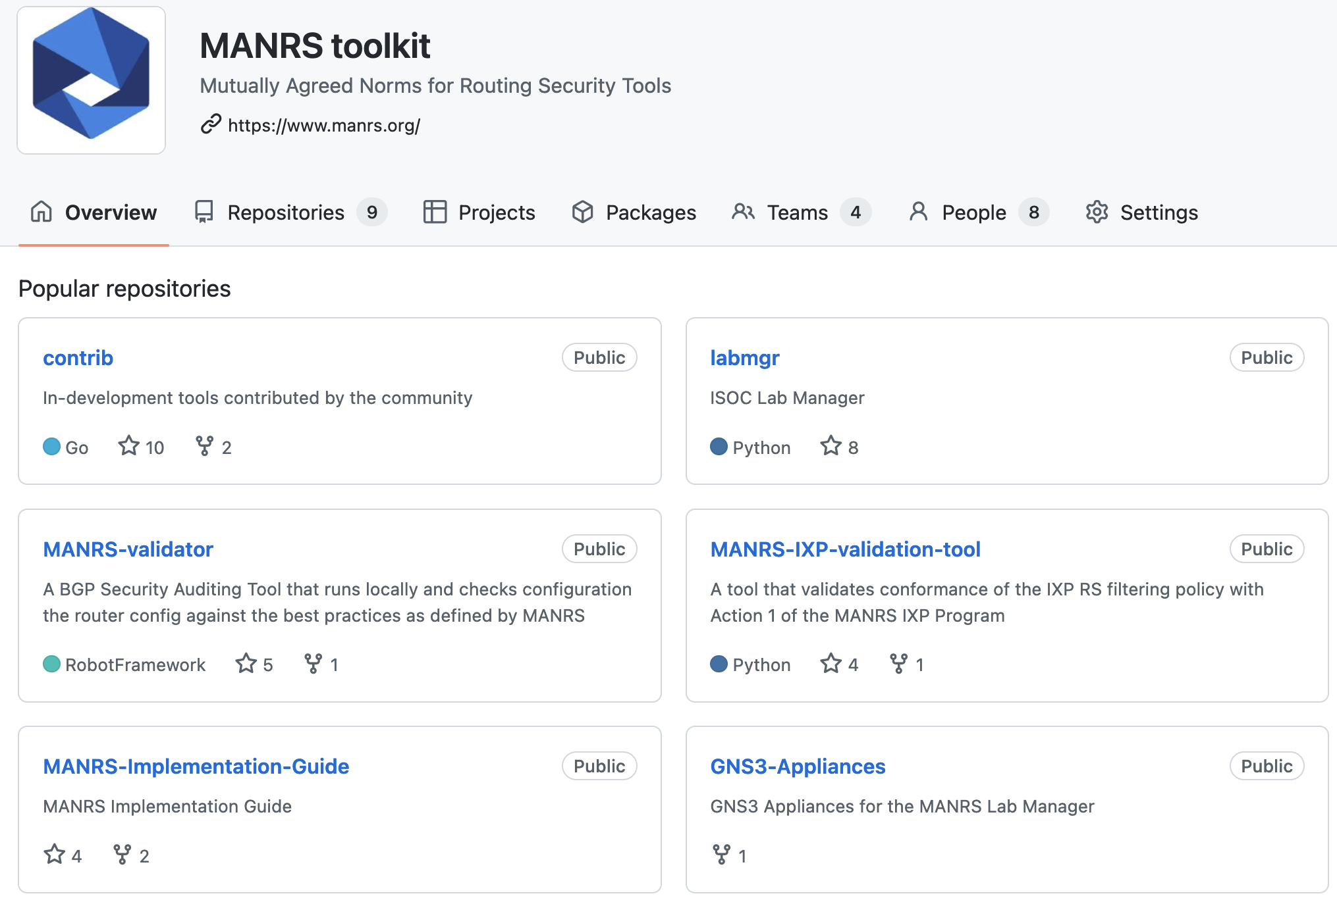

Slide 10
Self-governance: Steering Committee
9-member committee coordinates and develops the MANRS initiative, including:
Reviewing and improving MANRS Actions and conformance criteria
Supervising the auditing process for new applicants and handling appeals
Recommending suspension or termination of organizations fall short of minimum conformance criteria
Supervising incident handling processes
Appointing Advisors, Ambassadors, and Fellows
3 seats open in the November 2022 election

Slide 11
Measuring MANRS
Notes:
https://www.manrs.org/wp-content/uploads/sites/14/2017/10/MANRS-451-Study-Report.pdf

Slide 12
MANRS Observatory https://observatory.manrs.org/
Provides a factual state of MANRS readiness and tracks it over time
Measurements are:
Transparent – using publicly accessible data
Passive – no cooperation from networks required
Evolving – MANRS community decide what gets measured and how

Slide 13
MANRS Observatory

Slide 14
300
717 ISPs
104 IXPs
20 CDN & Clouds
6 Equipment Vendors
9
9

Slide 15
Progress in routing security
81% of all ASNs have their routes registered in the IRR and 27% in RPKI, and these numbers steadily grow.
Number of “culprits” – ASNs implicated in one or more suspicious routing events – declines
Data sources: MANRS Observatory, BGPStream, GRIP.

Slide 16
MANRS is an Important Step
Security is a process, not a state. MANRS provides a structure and a consistent approach to solving security issues facing the Internet.
MANRS is the minimum an operator should consider, with low risk and cost-effective actions.
MANRS is not a one-stop solution to all of the Internet’s routing problems, but it is an important step toward a globally robust and secure routing infrastructure.

Slide 17
Why join MANRS?
Improve your security posture and reduce the number and impact of routing incidents
Demonstrate that these practices are reality
Meet the expectations of the operator community
Join a community of security-minded operators working together to make the Internet better
Use MANRS as a competitive differentiator

Slide 18
Increasing the Value Proposition

Slide 19
Challenges and opportunities
The MANRS approach works
Community based
Leverages peer pressure
Provides reputational value
Areas for improvement
Weak business case – little commitment
Little incentive to excel
Requiring ongoing conformance is challenging
Caveats of the audit framework

Slide 20
MANRS+
Create a second, elevated tier of MANRS participation for network operators that comply with more stringent requirements and auditing
Focus on customer-provider relationships. Work with industry partners to increase demand for security from their connectivity providers
We need network operators and their potential customers willing to co-develop the requirements of the future quality mark with the goal of eventually incorporating it in procurement policies/recommendations

Slide 21
Scope of the Requirements (Actions)
MANRS+ requirements should be broader than the existing MANRS program baseline to make the certification or quality mark worth industry attention. It should be better aligned with the demands and expectations of business partners.

Slide 22
Conformance Tests
Auditing and conformance must provide a much higher level of confidence than current MANRS metrics.
Current MANRS auditing practices rely on passive measurements; MANRS+ will require active cooperation from the audited organization's networks (e.g. by asking them to run an auditing tool, or to provide additional information about their topology, or to participate in a measurement infrastructure, such as route collectors).

Slide 23
What’s next?
Join MANRS
Help us raise awareness about routing security
Contact us to get involved in elections, MANRS+ development, etc.
Ask your peers and providers about MANRS compliance

Slide 24
LEARN MORE: https://www.manrs.org
FOLLOW US:
/RoutingMANRS

Slide 25
manrs@isoc.org

