Slide 1
Outreach in Eurasia past February 2022

Slide 2
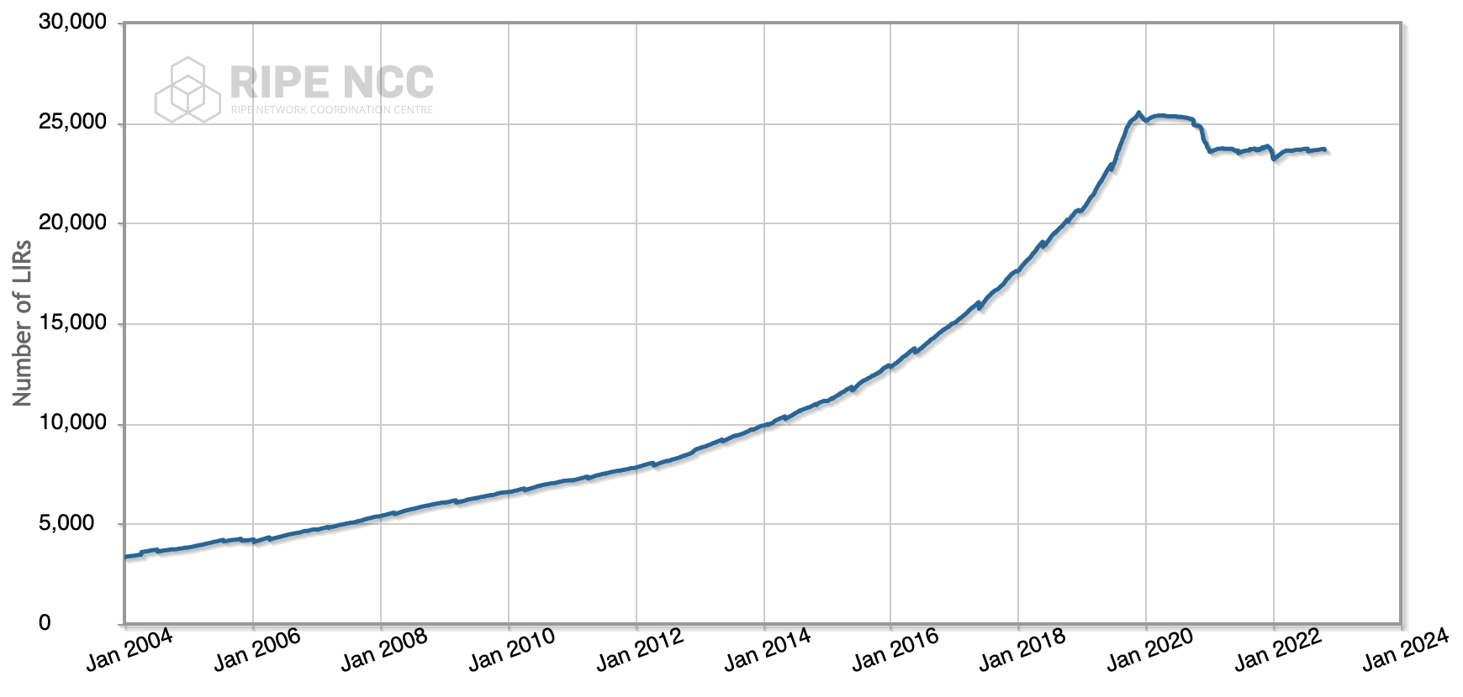
Total Number of LIRs in the RIPE region
Notes:
This is the dynamics of the aggregate number of LIRs in the RIPE region, updated as of twenty third of October, 2022.
Today, the total number of LIRs in the region is 23 thousand 7 hundred 4.

Slide 3
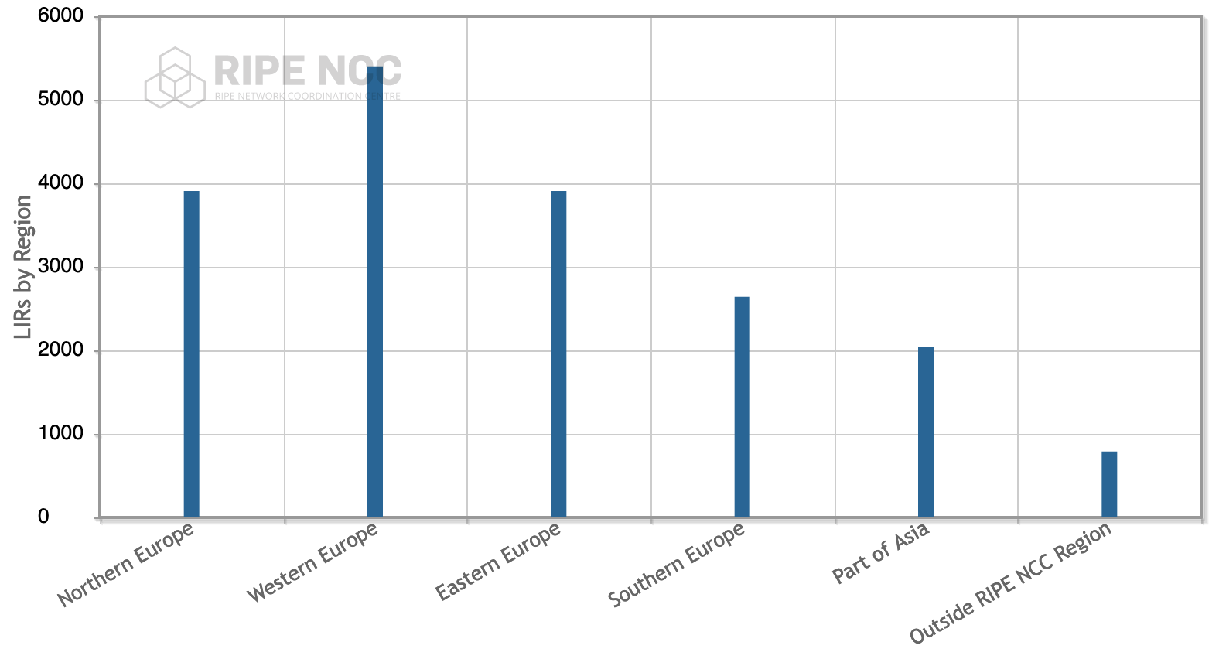
RIPE NCC Membership by Region
Notes:
And this is the distribution of LIRs by the sub-region as defined by the United Nations Statistics Division. Per UNSD, that “eastern european” part is essentially Belarus, Bulgaria, Czechia, Hungary, Poland, Republic of Moldova, Romania, Russian Federation, Slovakia, and Ukraine, to an aggregate of 3 thousand 9 hundred 8 LIRs.
Also per the same UNSD definitions, this graph includes “Part of Asia” meaning Middle East as well as Armenia, Azerbaijan, Georgia, Kazakhstan, Kyrgyzstan, Tajikistan, Turkmenistan, and Uzbekistan, and the aggregate for the “part of Asia” is 2 thousand 47.

Slide 4
Fundamental Outreach Issues
Around 20% of the RIPE NCC membership budget comes from outside the EU, Western and Central Europe
However, the RIPE community is largely skewed towards West
The NCC board and the external communications team recognized this discrepancy long ago
  Language barrier minimization attempts
  SEE
  MENOG
  ENOG

Slide 5
ENOG Timeline
Was officially announced in 2010
First meeting held in June 2011
Initially, was promising
2014-2015: half of the community disconnected
2019: host-less meeting in Georgia
2020-2021: pandemic
2022: a request to disband ENOG

Slide 6
ENOG Telegram Chat
666 members
ITNOG chat: 1308 members

Slide 7
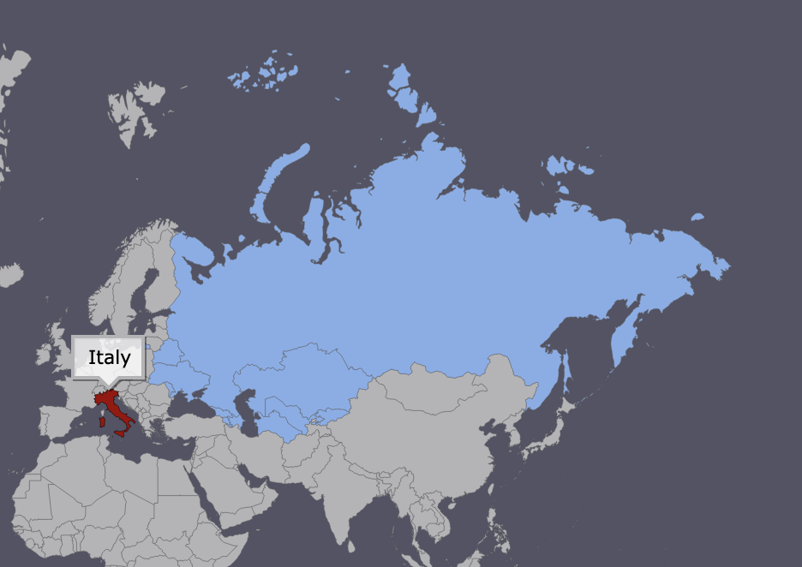
Italy and the ENOG region, area

Slide 8
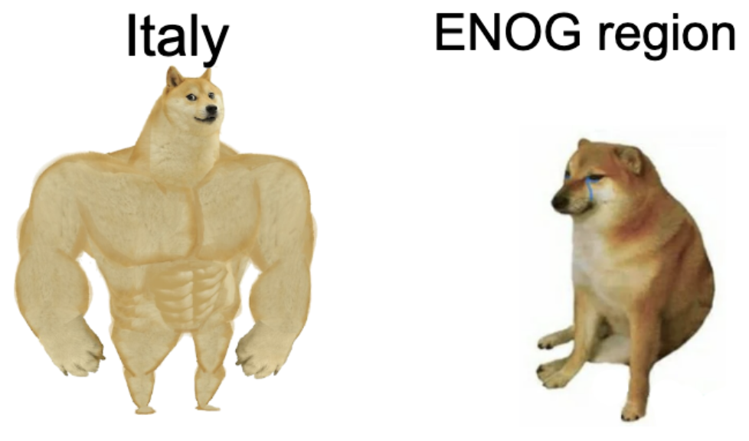
Italy and the ENOG region, RIPE participation

Slide 9
Situation as of 2022
No country in the ENOG sub-region could be travelled freely
Community meetings are the least of the problems
  Equipment shortages
  Missile attacks
  Short term planning
Membership fees becoming a challenge
  Cash issues
  Sanctions and counter-sanctions

Slide 10
What does the RIPE community want to do?
Short term
  What do LIRs need?
  Means of support for the LIRs?
Long term
  What could the sustainable regional design be?

